Slide 1

Documentation Consistency Assistant
An intelligent solution for maintaining perfect alignment between code and documentation in Python projects

Slide 2
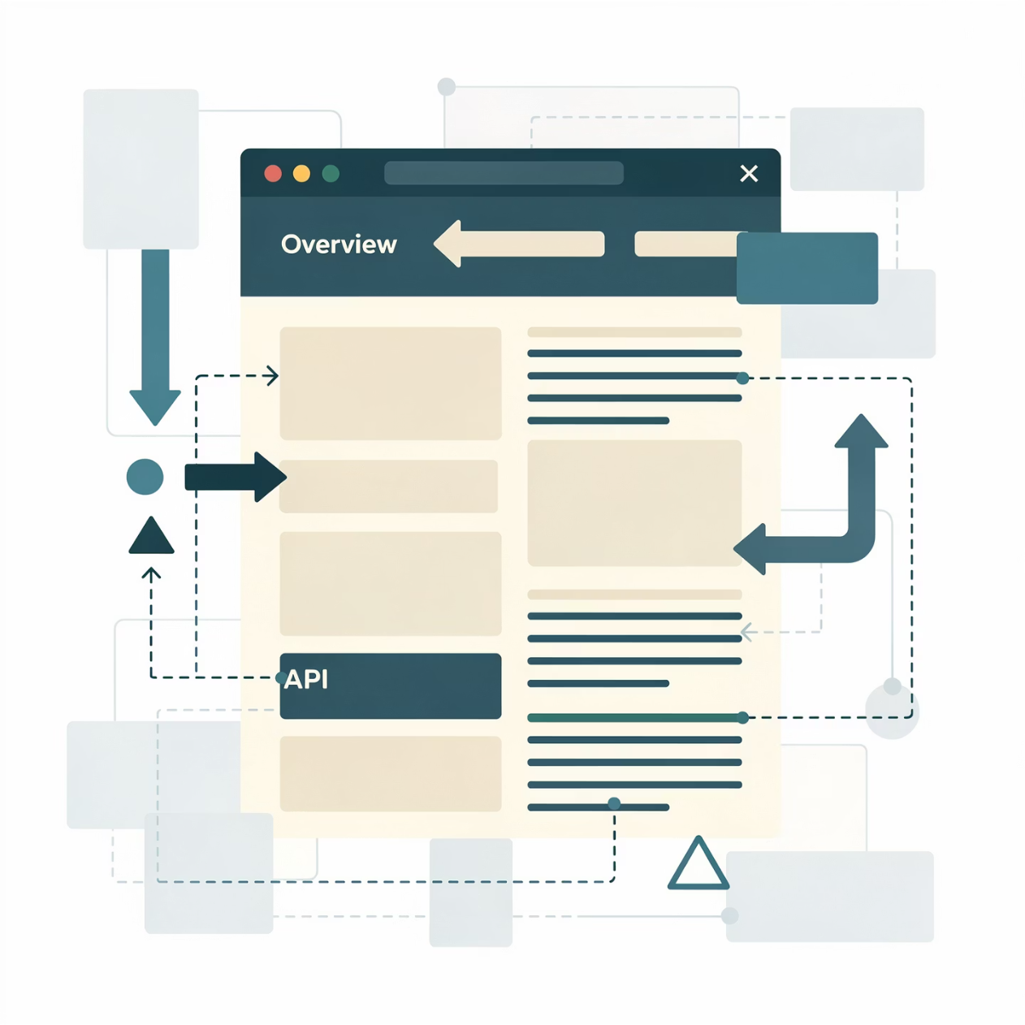

CONTEXT
The Documentation Gap Challenge
The Problem
Modern software projects face a persistent challenge: maintaining consistency between source code and documentation. As projects evolve rapidly, documentation often lags behind, creating barriers for new contributors and frustrating end users.
Key impacts: Extended onboarding time, increased maintenance complexity, reduced adoption rates for open-source projects, and heightened risk of errors from outdated information.
Traditional approaches like manual reviews and automated docstring generators only solve part of the problem—they don't verify alignment between code and external documentation.

Slide 3
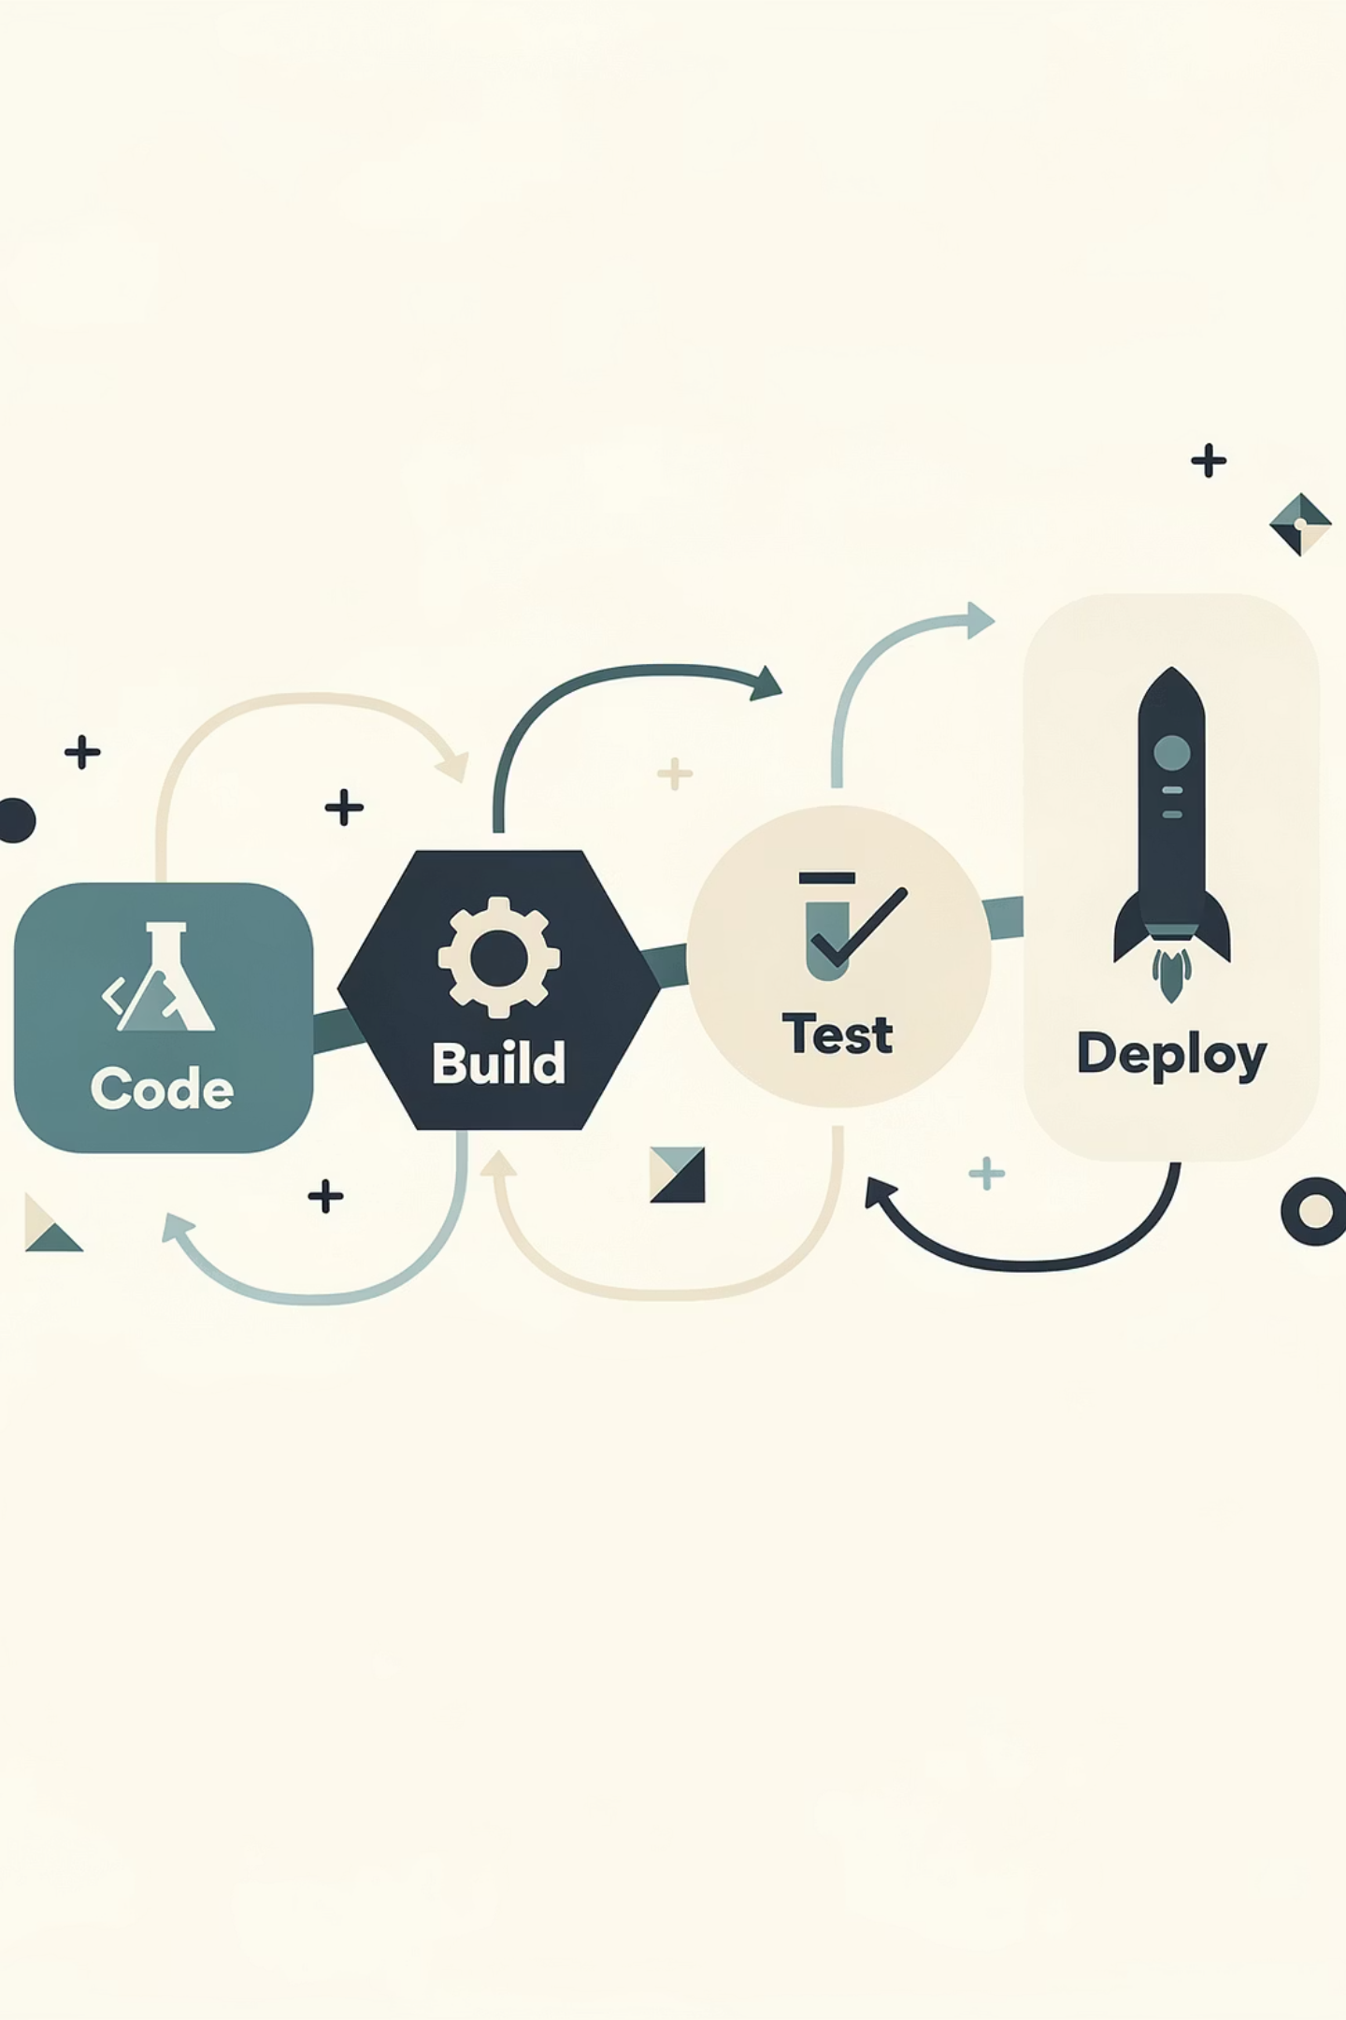

SOLUTION
Intelligent Documentation Analysis
Complete Automation
Contextual Intelligence
Eliminate manual reviews by automatically scanning entire projects, extracting code structure and documentation, then producing comprehensive reports without human intervention.
Go beyond detection with AI-powered suggestions that provide actionable fixes adapted to each code element's context, transforming the tool into a true documentation assistant.
Native CI/CD Integration
Seamlessly integrate into modern development workflows and Git platforms to ensure continuous documentation quality checks throughout the development cycle.

Slide 4
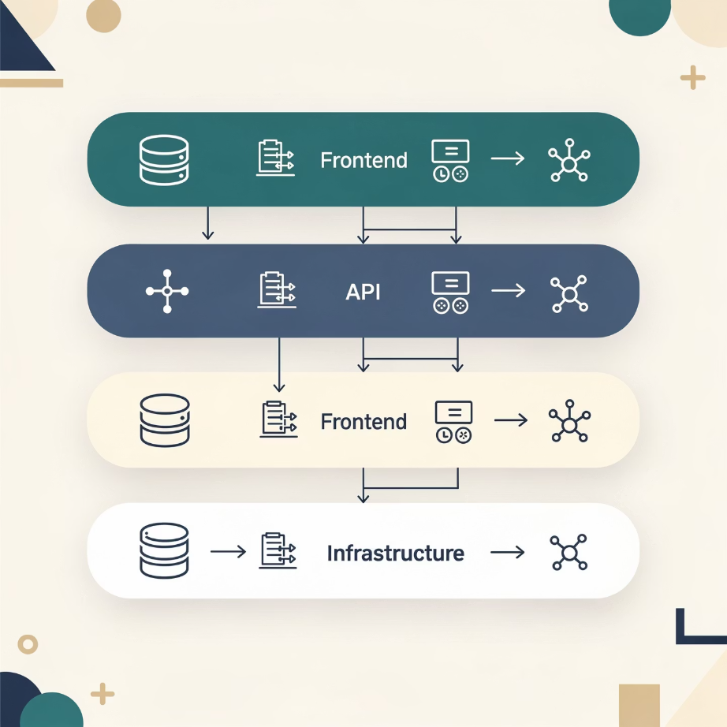
ARCHITECTURE
Modular Technical Foundation
Four-Layer Architecture
01
Analysis Layer
Extracts and interprets data from code and documentation using AST parsing and Markdown processing
02
Generation Layer
Produces contextual suggestions, high-definition visualizations, and Mermaid diagrams
03
Orchestration Layer
Coordinates the complete analysis pipeline and manages data flow between modules
Benefits: Independent module development, reusable components across contexts, comprehensive unit testing, and seamless feature extension.
04
Interface Layer
Handles user interactions through Streamlit web interface with comprehensive security validation

Slide 5





WORKFLOW
Complete Analysis Pipeline
Input Validation
Secure validation of ZIP archives or local folders with comprehensive safety checks
Code Extraction
AST-based parsing identifies all classes, functions, and methods with their metadata and docstrings
Documentation Parse
Comprehensive scanning of Markdown, RST, and text files to build searchable documentation index
Smart Comparison
Intelligent matching algorithm detects inconsistencies and calculates documentation health score
AI Suggestions
Context-aware recommendations with optional GPT integration for intelligent documentation generation

Slide 6

IMPACT
Transforming Documentation Quality
70%
85%
Time Saved
Coverage Improvement
Reduction in manual documentation review effort
Average documentation completeness increase
3x
Faster Onboarding
New contributor ramp-up acceleration
Real-World Benefits
Developers: Automated gap identification with AI-powered suggestions eliminates writer's block
Teams: Objective quality standards with CI/CD integration prevent documentation debt accumulation
"The Documentation Consistency Assistant bridges the critical gap between source code and external documentation—a space largely unexplored by existing tools."
Organizations: Portfolio-wide quality audits establish consistent documentation standards

